Slide 1
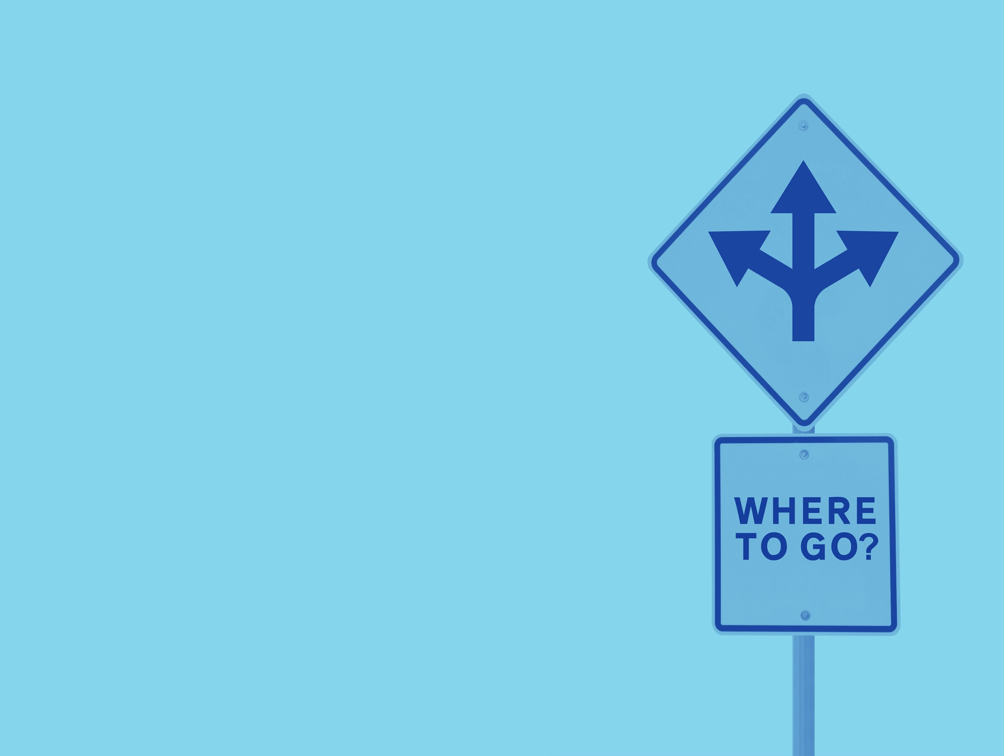
How We
Are Affected
by Others

Slide 2

Spot the Fake
Notes:
Instructor Notes:
Remind students that behavioral economists use experiments to determine how people respond in various situations.
Let students know they will be participating in an activity in which they will be rotating to various stations. Each one will have three short descriptions of experiments. Two are based on real experiments performed by behavioral economists and one is a “fake.”
Point out the locations of each stop and determine where each group will begin. Inform students this will be a silent carousel walk. At each stop, their group will read and consider the situations and each member will have the chance to write notes on the surrounding paper or whiteboard with their thoughts. Each group member should add a unique comment about one or more of the three experiments. They might share a reason they think one is true, for example, or explain why one might be the “fake.”
Let students know that when you call time, they will be asked to move to the next stop. This will repeat until each group has been to all three stops (A, B, and C). At their second and third stops, students may choose to add completely new information or add comments to what previous students have written. Remind students that they should be “talking” through their written comments throughout the activity.
When students are done, have them return to their seats.

Slide 3
A
People are given a set of numbers (2, 4, 6). They are asked to come up with three numbers that have a similar pattern. They can guess patterns, and the experimenter will let them know if they are correct.
Researchers observe the amount of food people
eat when alone versus when they are with a group
of people.
Students are asked to sit in the front row of the class. An observer tracks which ones accept the invitation.
Notes:
Instructor Notes:
Review the experiment descriptions in Spot the Fake A along with student responses on the associated papers or whiteboards.
Click to display the correct answer. Number three is the “fake.”
Discuss the two real experiments.
Number 1: Ask students for examples of answers they would provide for the first experiment.
Number 2: Students may recall this experiment being described in a previous lesson. If so, let students have a jumpstart on the next activity. If not, let students know it is okay, and they will get more information shortly.
Let students know that you will discuss all six of the true experiments again later in the lesson.

Slide 4
B
People are asked to select an investment plan from a list. One group’s list had many options. The other had only a few. Participants were asked for their decision.
Restaurant goers were asked how much they would pay for items on a menu by reading only the descriptions and then again after tasting the food.
College students with opposing views on capital punishment read two pretend studies (one saying it helps deter criminals and the other that it didn’t). They were asked how convincing the studies were.
Notes:
Instructor Notes:
Repeat the process with Spot the Fake B by reviewing student responses. Ask students if it was easier or harder to comment silently when they could see the information left by the previous group.
Click to show that number two is the “fake.”
Discuss the two real experiments.
Number 1: Ask students if they believe more people made a decision when given many options or just a few.
Number 3: Tell students that this experiment was conducted with students at Stanford University and that many similar studies have been done since. Ask students how people’s original opinions about capital punishment might influence their reactions to the studies.

Slide 5
C
Voters were asked their opinions on policy issues and then given fabricated poll results on the same topics. They were asked if their opinions changed and why.
Restaurant goers were asked how much they would pay for items on a menu by reading only the descriptions and then again after tasting the food.
Shoppers at an upscale grocery store encountered a tasting booth with either 6 or 24 different flavors of jam. Researchers tracked how many approached the booth and how many made a choice.
Notes:
Instructor Notes:
Repeat the process again with Spot the Fake C by reviewing student responses.
Click to show that number two is the “fake.”
Discuss the first real experiment, number 1. Let students know that there are many variations on this experiment and that most have the same result: people change their votes after seeing the polls. Ask why they think people do this. Would they?

Slide 6
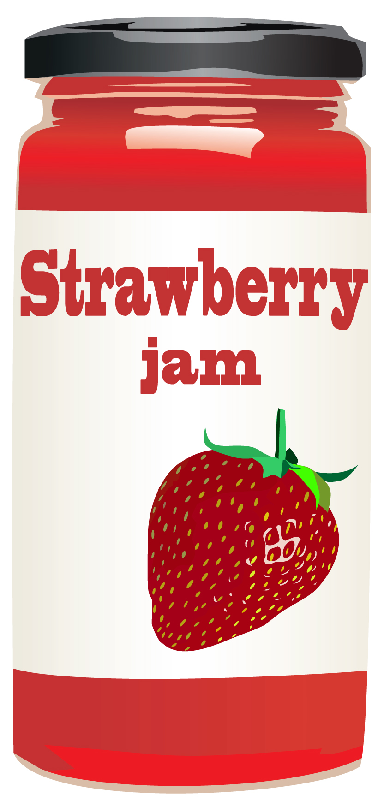
Just Jams?
Notes:
Instructor Notes:
Inform students that the final scenario is another example of a real experiment. Share with students that economists and other social scientists who conduct these experiments frequently write about them in order to share what they learned with others. When doing so, they must describe the setup of the experiment in detail.
Distribute a copy of Just Jam? to each student. Ask all students to read the overview. Then assign small groups to read and discuss the different sections: Participants and Experimental Site, Product Selection, and Procedure.
Challenge students to predict the outcome of the experiment. On average, how many jams did customers try when offered 6 choices? 24 choices? Which group was more likely to buy one or more of the jams they sampled?

Slide 7

Notes:
Instructor Notes:
Play the video.
Invite students to give an example of a time when they might have been influenced by herding. Do they think herding is good, bad, or neutral?

Slide 8

Sort the Experiments
Notes:
Instructor Notes:
Distribute a copy of Sort the Experiments to each student. Challenge them to determine which experiments are examples of herding and which are examples of decision paralysis. Let them know that some represent a third or “other” concept about which they have yet to learn

Slide 9


Herding
Researchers observe the amount of food people eat when alone versus when they are with a group of people.
Voters were asked their opinions on policy issues and then given fabricated poll results on the same topics. They were asked if their opinions changed and why.
Notes:
Instructor Notes:
Ask students which experiments they believe were examples of herding.
Click to share the answers and discuss them using the following as a guide:
Researchers have found that when people eat with others, their behavior is often different than when they eat alone. Do you think you eat as much when you eat alone as you do when you are with others? What would make you eat more? Less?
How might hearing the results of a poll influence your opinion? One study from Stanford University professors found that the extent to which people’s opinions changed depends on the type of poll. People’s opinions are most changed if the poll surveyed experts, followed by people with similar views, and then the general public. Why might this be?
^{[1]} How Polls Influence Behavior, Stanford Graduate School of Business

Slide 10
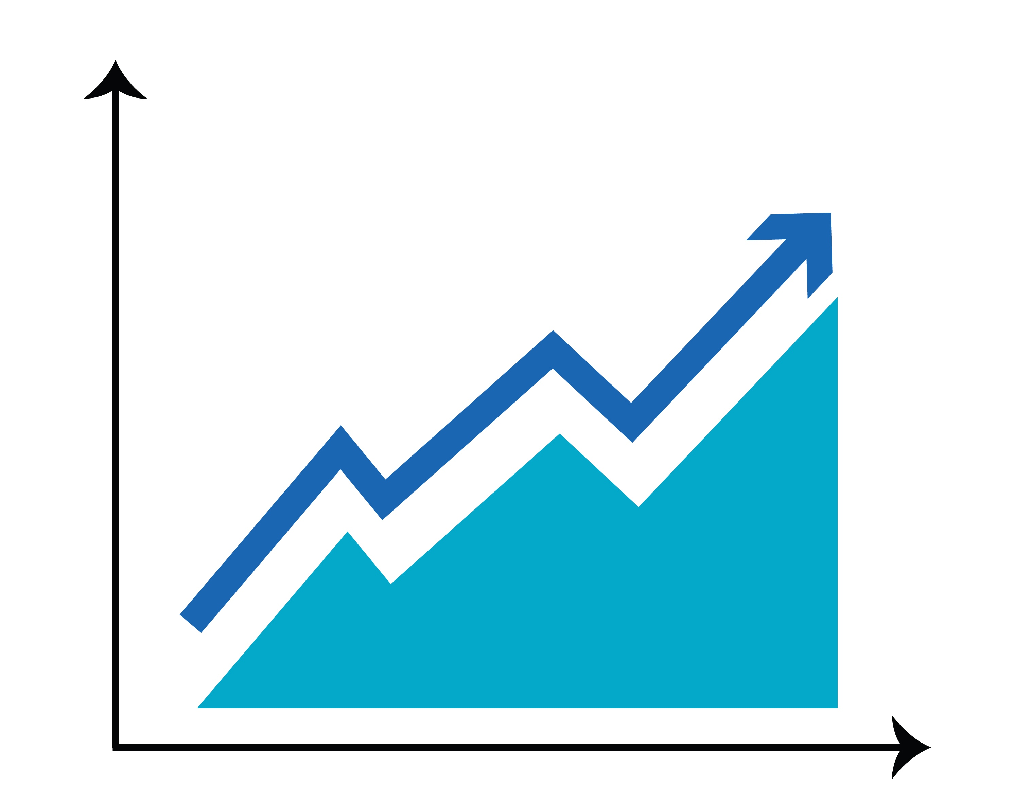
Herding in Investing
What might happen if investors follow the “herd?”
Examples of herding in the stock market:
an expert says something is a great investment
lots of people start investing in a new technology (without doing their own homework)
scammers buy stocks to make the price go up and then sell
Notes:
Instructor Notes:
Challenge students to consider how herding could influence the stock market or investors.
Click to share several examples of herding impacting investors.
Let students know that the final example is a common investment called a pump and dump scam

Slide 11
Decision Paralysis
People are asked to select an investment plan from a list. One group’s list had many options. The other had only a few. Participants were asked for their decision.
Shoppers at an upscale grocery store encountered a tasting booth with either 6 or 24 different flavors of jam. Researchers tracked how many approached the booth and how many made a choice.
Notes:
Instructor Notes:
Of the remaining experiments, find out which ones students believe are examples of decision paralysis.
Click to share both answers.
Share with students that economists generally favor giving people choices. However, at some point too many choices become problematic. Ask students at what point they think there are too many choices.
Challenge students to give examples of times they have been overwhelmed by the number of choices. Did they make a choice? Was it harder? If students struggle to think of an example, ask if they have ever been to a restaurant with a really long menu. Does having more choices make it easier or harder for them to choose?

Slide 12
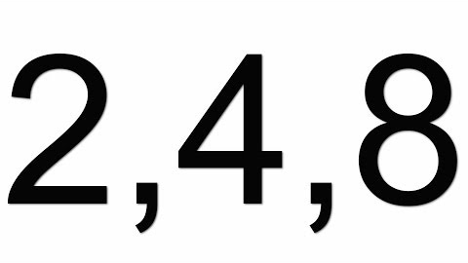
Notes:
Instructor Notes:
Show the students the video and stop it at 1:46.
Point out that this person is conducting a version of the 2-4-6 experiment which was developed many years ago by a man named Peter Wason.
Ask students if the participants in the experiment behaved as they would have if they had been asked the question. Point out that participants continued to guess similar patterns as opposed to trying to disprove the one they had already guessed.

Slide 13
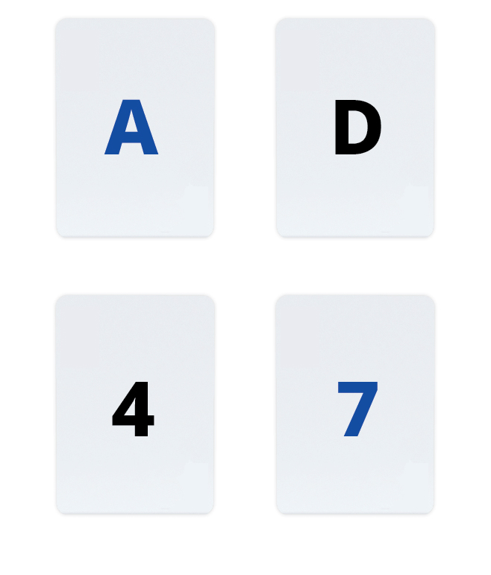
The Four Card Task
Suppose each card has a number on one side and a letter on the other. Which of these cards are worth turning over if you want to know whether the statement below is false?
"If a card has a vowel on one side, then it has an even number on the other side."
Notes:
Instructor Notes:
Inform students that the same person, Peter Wason, developed several other experiments including one called the Four Card Test.
Invite students to read the problem and answer the question on their own. Then, direct students to compare answers with a partner.
Click to reveal the correct answer.
Explain the answer. The only way to disprove an "if X, then Y" statement ("if there is a vowel on one side, then there is an even number on the other") is by finding an instance of "X and not Y" ("there is a vowel on one side and an odd number on the other"). The cards with the D and 4 are irrelevant, because neither can show a vowel and odd number combination.
Share that in an experiment^{[1]} by Wason and a colleague, nearly half of the people studied chose A and 4. The next most popular answer was A by itself. In other words, most people chose cards that would confirm the statement rather than disproving it
^{[1]} Wason, P. C., & Johnson-Laird, P. N. (1972). Psychology of Reasoning: Structure and Content. Cambridge, MA: Harvard University Press.

Slide 14
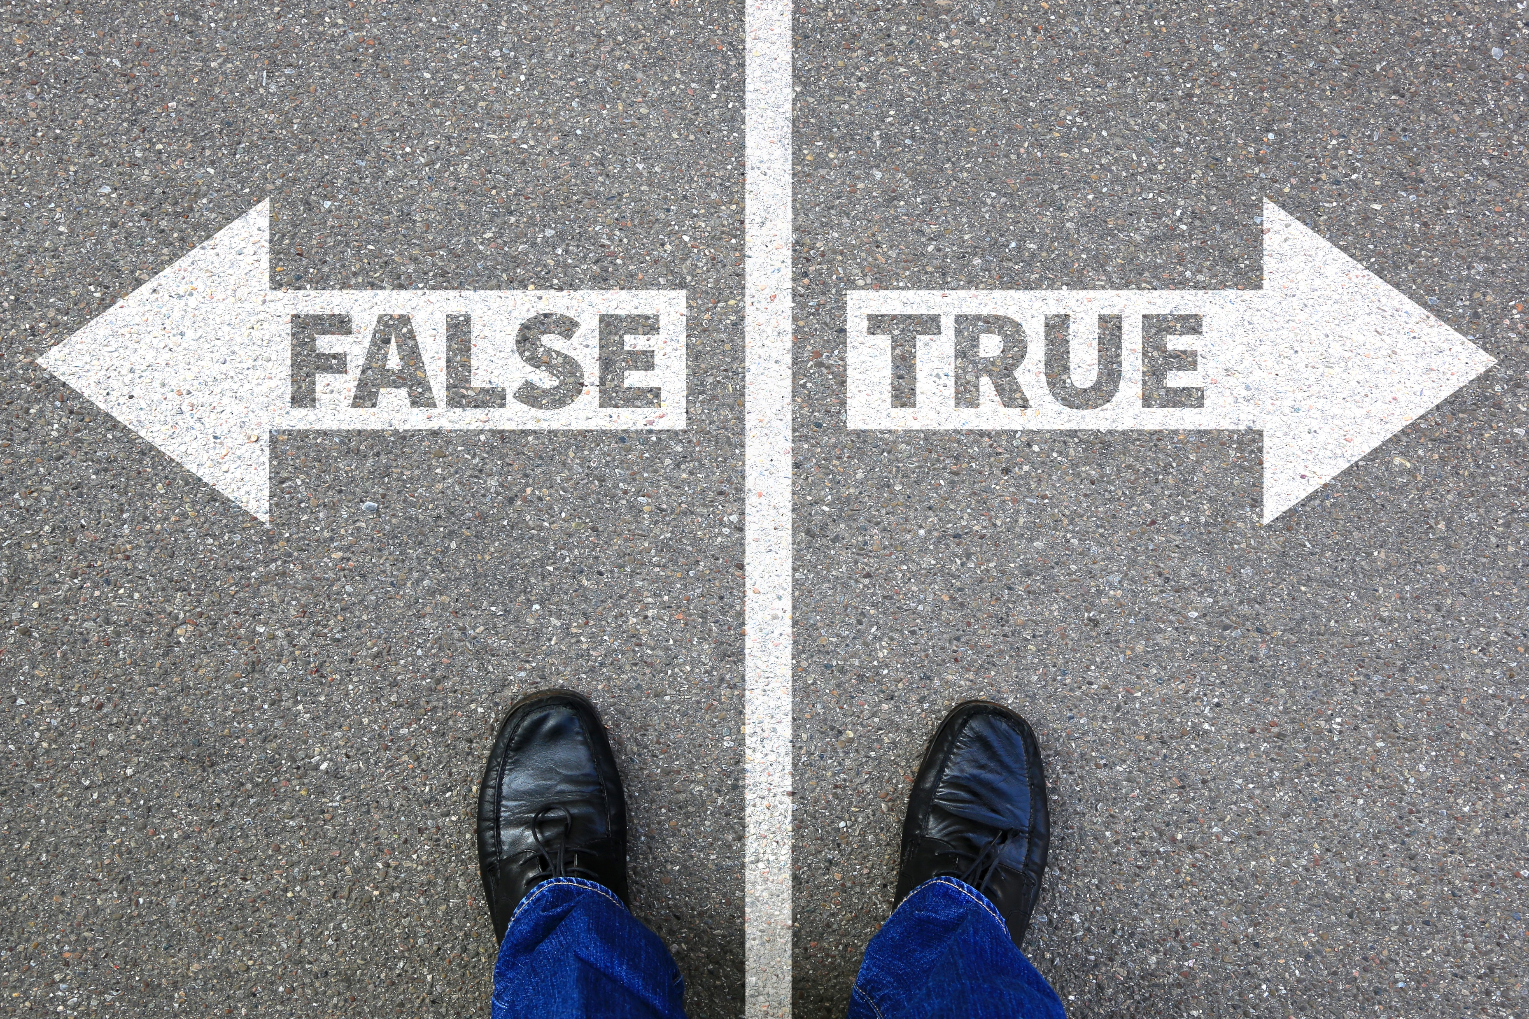
Confirmation Bias
People are given a set of numbers (2, 4, 6). They are asked to come up with three numbers that have a similar pattern.
College students with opposing views on capital punishment read two pretend studies (one saying it helps deter criminals and the other that it didn’t). They were asked how convincing the studies were.
Notes:
Instructor Notes:
Tell students that the tendency to seek out confirming evidence is known as a "confirmation bias” — a phrase coined by Wason.
Challenge students to explain how the second experiment could be used to prove confirmation bias. (The students in the experiment who agree with capital punishment rated the study that says it helps deter criminals more than the other one and vice versa).
Remind students of the previous experiment about polling and herding. People’s minds were changed more by polls of experts or like-minded individuals. How is this related to confirmation bias, too?

Slide 15
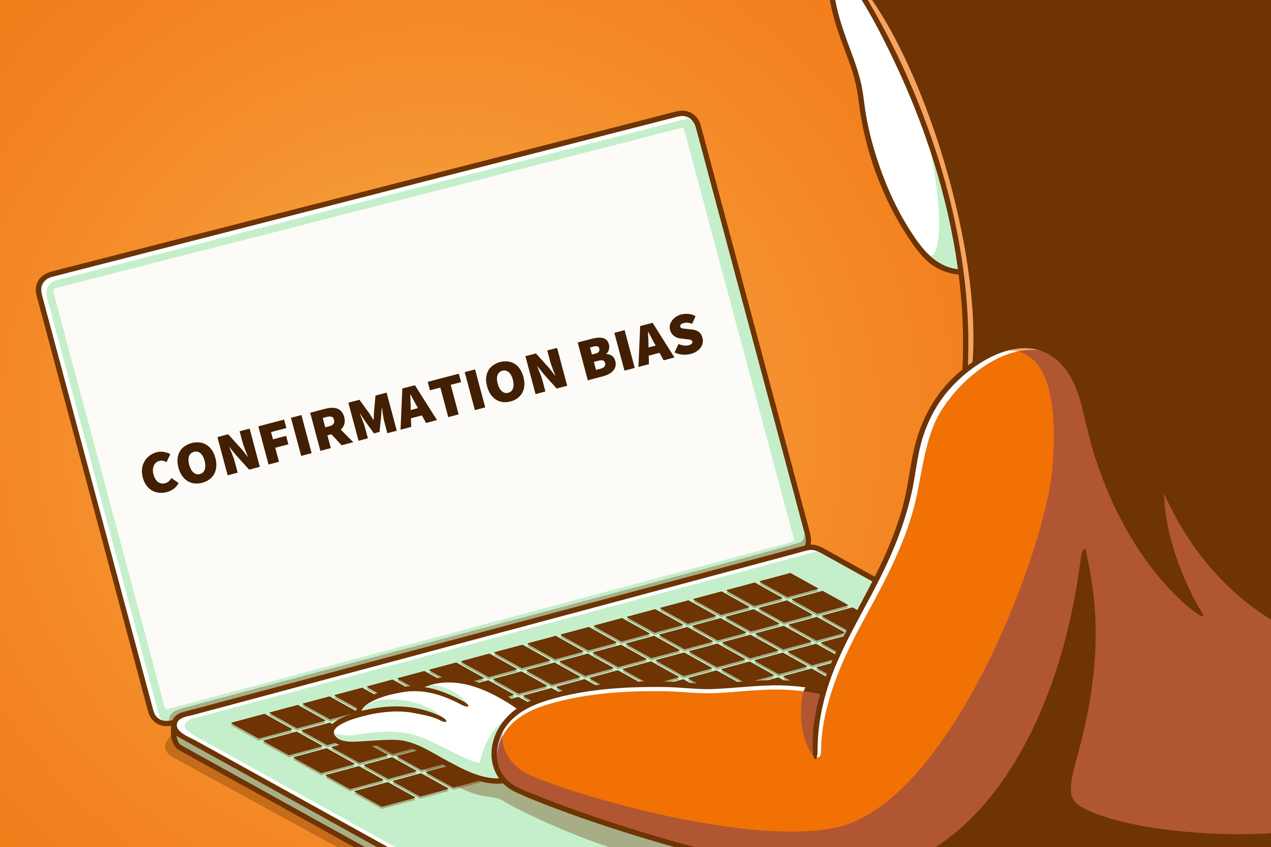
Confirmation Bias
The tendency of people to interpret new information in a way that supports their pre-existing beliefs
Notes:
Instructor Notes:
Share the definition of confirmation bias with students.
Invite students to think about a time they might look for information to confirm their own opinions rather than disproving them.

Slide 16
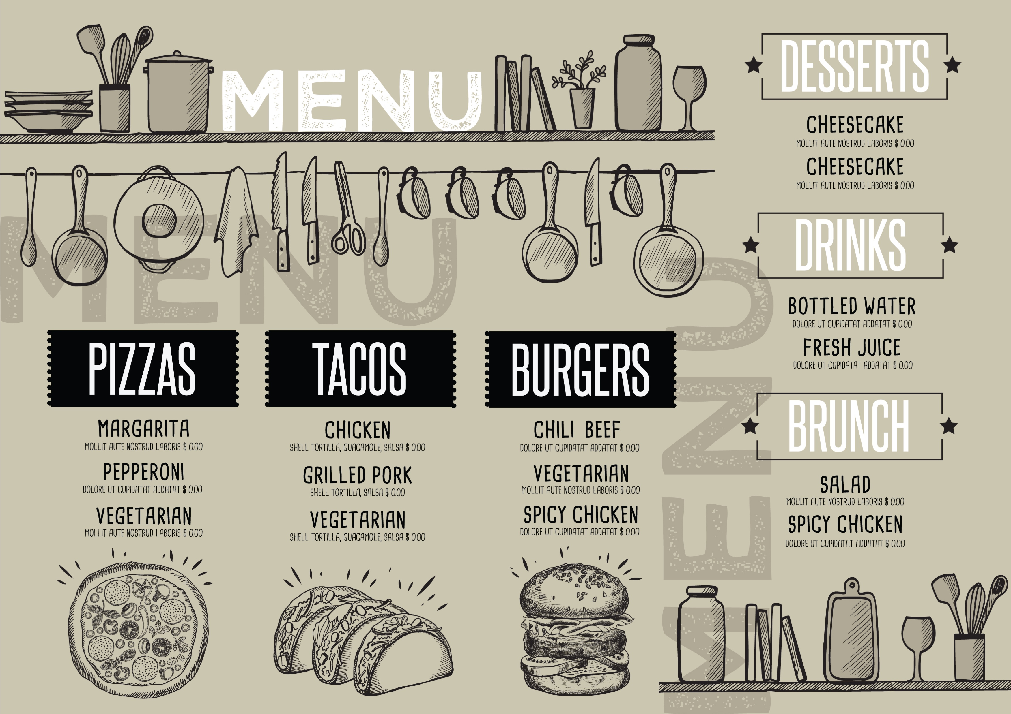
Menu Engineering
Notes:
Instructor Notes:
Remind students that in the first session they learned about more concepts from behavioral economics, including herding, decision paralysis, and confirmation bias.
Remind students that the basis of behavioral economics is that individuals often make irrational decisions. They are influenced by a variety of factors including what others think and more. Businesses and others often use this knowledge to encourage customers to make more or specific purchases.
Let students know that they will be applying this knowledge and other ideas from behavioral economics to eating out, or — more specifically — the design of restaurant menus.

Slide 17
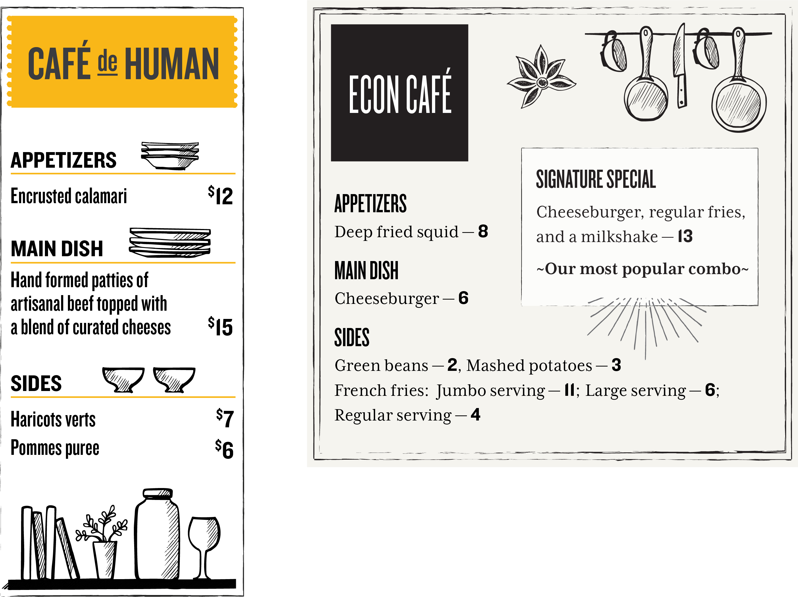
Notes:
Instructor Notes:
Display the first menu. Ask students what they might select from this menu.
Click to display the second menu. Challenge students to compare and contrast the two menus. Point out that many of the menu items are very similar but described in different ways. For example, haricots verts and pommes puree are French for green beans and mashed potatoes.
Share with students that restaurant menus are often designed to encourage very specific customer behaviors. For example, they hope that:
People will pay more for items with detailed or fancy descriptions.
If they provide a very expensive option, people will pick the one that is slightly less but not the least.
Pointing out a popular item will encourage people to purchase it (herding).
Keeping the number of items to a reasonable amount will encourage people to make a choice (avoiding decision paralysis)

Slide 18
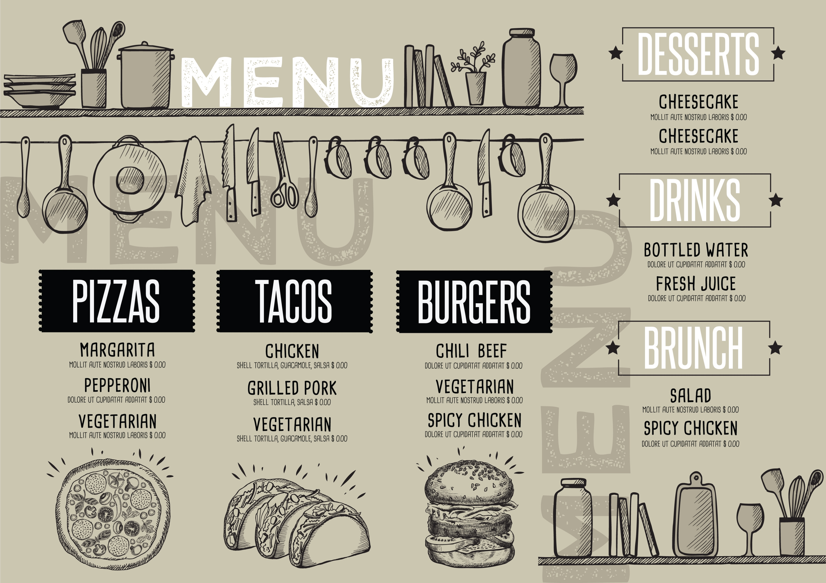
Activity: Analyze the Menus
What type(s) of restaurant
menus you will analyze.
Similar or different types
of restaurants?
Chain or local?
Fancy or casual?
Notes:
Instructor Notes:
Inform students that they will be working in small groups to analyze restaurant menus. Each group should locate and evaluate at least two restaurants.
Allow time for students to divide into groups, decide which restaurants they will use, and locate the menus.
Distribute a copy of On the Menu to each student or group. Direct students to consider the questions on the handout when analyzing the menus they selected.
Invite students to share their findings with the class. Challenge students to compare and contrast the menus and what they found.
Use the On the Menu Facilitation Guide to engage students in a discussion about what they found.
Ask students how they will look at menus differently in the future. Will their choices be influenced by knowing some of the “tricks?”

Slide 19

Risk on the Ranch
Futures
Spotlight
Notes:
Instructor Notes:
Inform students that they will be working in small groups to analyze restaurant menus. Each group should locate and evaluate at least two restaurants.
Allow time for students to divide into groups, decide which restaurants they will use, and locate the menus.
Distribute a copy of On the Menu to each student or group. Direct students to consider the questions on the handout when analyzing the menus they selected.
Invite students to share their findings with the class. Challenge students to compare and contrast the menus and what they found.
Use the On the Menu Facilitation Guide to engage students in a discussion about what they found.
Ask students how they will look at menus differently in the future. Will their choices be influenced by knowing some of the “tricks?”

Slide 20


Would You Rather…
You will
eat some vegetables.
be told what to do?
or
be given a choice of what to do?
Would you like carrots or broccoli?
Notes:
Instructor Notes:
Pose the “Would you rather…” question to students.
Click to show examples. Discuss responses. Which is preferred — being told what to do or being given a choice?

Slide 21
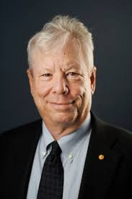
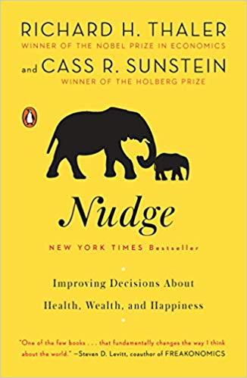
Richard Thaler
You will
eat some vegetables.
Behavioral economist
Professor, University of Chicago
Author:
Nudge
Misbehaving
Would you like carrots or broccoli?
Notes:
Instructor Notes:
Inform students that Professor Richard Thaler, one of the “fathers” of behavioral economics, was recognized for his efforts with a Nobel Prize in Economics in 2017. He is very well known for co-writing the book Nudge: Improving Decisions About Health, Wealth, and Happiness.
Explain that Thaler and Sunstein propose that choices can be provided to people in such a way that they are still given options but that their behavior is influenced or “nudged” in a particular direction.
Click to reveal the conversation bubbles from the previous slide. Ask students to consider how the choice given (“carrots or broccoli”) still led to the desired outcome (eating vegetables).

Slide 22
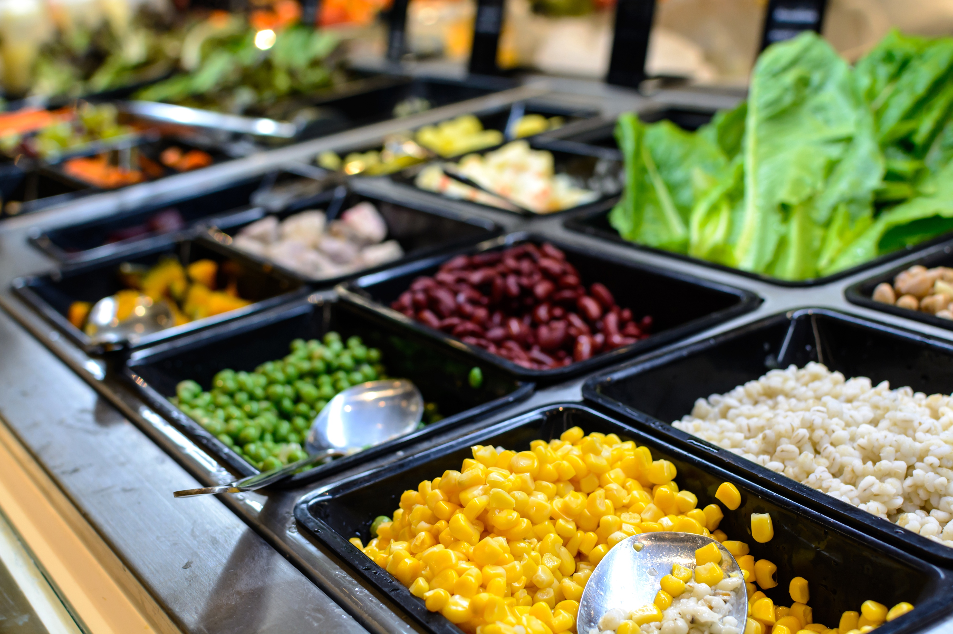
Nudge Example: The Salad Bar
Notes:
Instructor Notes:
Challenge students to consider another example: the placement of a salad bar in a school cafeteria. If school officials want students to make healthier choices, should they place the salad bar at the back of the cafeteria or in the middle where it must be passed?
Remind students that in either position, students still have a choice of whether or not to get a salad. However, by placing the salad bar toward the front or middle, they are “nudging” students to get a salad and make a healthier food selection.
Challenge students to consider their own school cafeteria. Where is food placed? Are student decisions being influenced by their placement? If so, how?

Slide 23
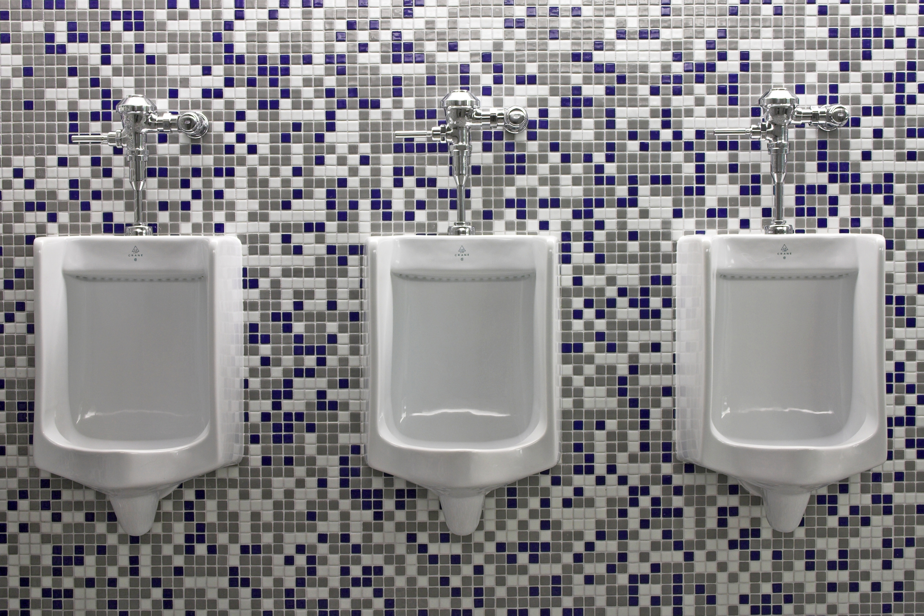
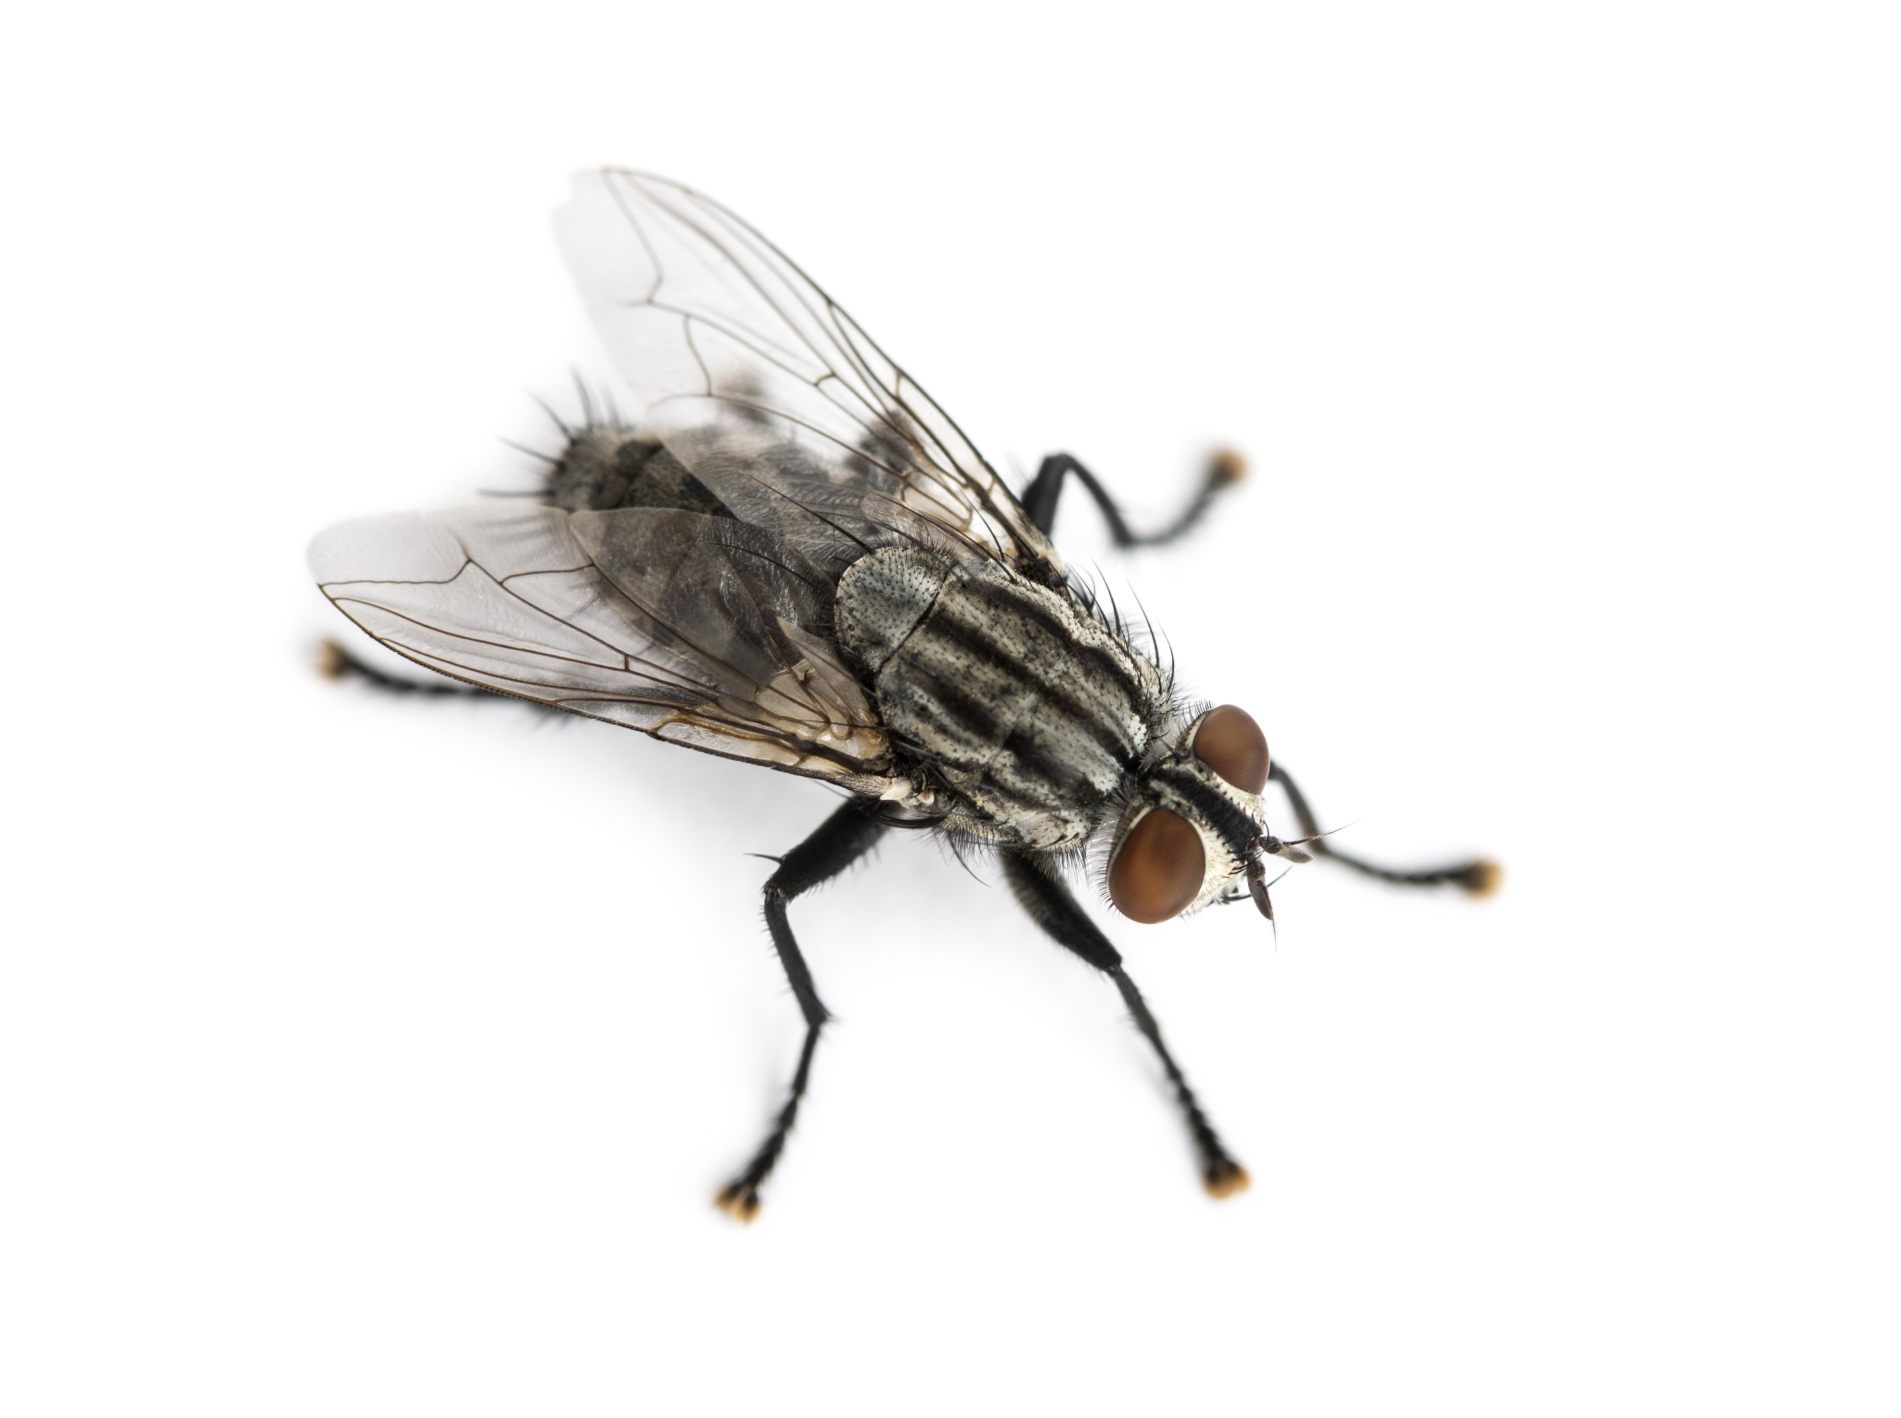
Nudge Example: The Fly & The Urinal
+
Notes:
Instructor Notes:
Ask students what a fly and a urinal might have to do with nudges?
Share that the Amsterdam International Airport saw an 80% reduction in urinal “spillage” when it etched small flies near the drains of the urinals. Ask students why they think that is.
Explain that the concept has caught on and can be found in urinals around the world. While this may seem trivial, ask students to consider the implications to cleaning costs and sanitation.

Slide 24

Nudge Example: Retirement Savings
Notes:
Instructor Notes:
Let students know that governments also use the idea of nudges to influence people’s decisions. In response to concerns that people were not saving enough for retirement, the U.S. government now allows employers to automatically enroll new employees in a retirement plan.
Challenge students to consider how decision paralysis plays into this nudge.
Explain that when given a choice to enroll or not enroll, most people do not enroll. They are often overwhelmed by the options. Not enrolling means they save less.
When people are automatically enrolled, they still have a choice to withdraw from the savings plan. However, most do not. As a result, they end up saving more.

Slide 25

Activity: Choice Architecture in Action
What course do you think more (or less) students should take?
Analyze the documents and/or process by which students select courses.
How can their decisions be “nudged” in a particular direction?
What behavioral economics concepts could be applied when nudging student behavior?
Notes:
Instructor Notes:
Let students know that they will be playing the role of choice architects — people who create choices with the purpose of influencing decisions or behaviors. Working in small groups they should consider the course registration or selection process at their school. If possible, they should review documents such as a program of study or course selection guide.
Challenge them to consider:
What course do you think more (or less) students should take?
Analyze the documents and/or process by which students select courses.
How can their decisions be “nudged” in a particular direction?
What behavioral economics concepts could be applied when nudging student behavior?
Invite groups to present their nudges and invite other students to consider the impact each might have.
Optional: Allow students additional time for research and development of their ideas and have them present at another class session.

Slide 26

Challenge: Nudging Teen Decision Making
Brainstorm decisions teens make that could be improved.
Understand the decision-making process.
Develop a “nudge.”
Answer the questions
Notes:
Instructor Notes:
Distribute a copy of the Nudging Teen Decision Making Challenge to each student.
Brainstorm decisions that teens make which could use improvement. Record student responses.
Allow students to form small groups or work independently to further consider specific decisions and propose nudges.
Invite students to share their recommendations with the class. Lead a class discussion about how realistic some of these nudges are to implement and what next steps could be taken to implement one or more, if desired.

Slide 27

Choice Architecture and You
Will knowing “better” make you “do” better?
Can you recognize when a choice has been created in
a way that will influence your decision?
If so, will it make a difference to how you think about your decision and/or the choice you make?
Notes:
Instructor Notes:
Invite students to consider how their understanding of nudges, behavioral economics, and choice architecture changes the way they think about their own decisions and/or how others might be trying to influence them without knowing it.
Ask students if knowing the “tricks” businesses use to influence people’s decisions will help them make more informed choices and recognize attempts to influence them in the future.
Click to show the additional questions and discuss each.
Challenge students to think about ways that they can remind themselves of what they learned and help use this knowledge to make better choices in the future.

